Slide 1


Slide 2

JSON in C++: designing a type for working with JSON values
Pavel Novikov
@cpp_ape

Slide 3
Plan for this talk
quick overview of JSON
design for a C++ type for working with JSON values
standard containers, std::variant
C++ allocator support

Slide 4
Constraints for this talk
Constraints for the implementation:
use C++17
write as little code as possible (while maintaining reasonable design and performance)
Not in this talk:
JSON string escaping
serialization/stringification
parsing

Slide 5
Overview of JSON
Douglas Crockford specified JSON in the early 2000s.
RFC 8259
null | null
true or false | Boolean
3.14 | number
"hello" | string
[ 1, 2, 3 ] | array (sequence)
{ "key": "value" } | object (dictionary)
primitive types
or
scalar types
structured types
or
collection types

Slide 6
Overview of JSON
JSON-text = ws value ws begin-array = ws %x5B ws ; [ left square bracket begin-object = ws %x7B ws ; { left curly bracket end-array = ws %x5D ws ; ] right square bracket end-object = ws %x7D ws ; } right curly bracket name-separator = ws %x3A ws ; : colon value-separator = ws %x2C ws ; , comma ws = *( %x20 / ; Space %x09 / ; Horizontal tab %x0A / ; Line feed or New line %x0D ) ; Carriage return value = false / null / true / object / array / number / string false = %x66.61.6c.73.65 ; false null = %x6e.75.6c.6c ; null true = %x74.72.75.65 ; true object = begin-object [ member *( value-separator member ) ] end-object member = string name-separator value array = begin-array [ value *( value-separator value ) ] end-array | number = [ minus ] int [ frac ] [ exp ] decimal-point = %x2E ; . digit1-9 = %x31-39 ; 1-9 e = %x65 / %x45 ; e E exp = e [ minus / plus ] 1*DIGIT frac = decimal-point 1*DIGIT int = zero / ( digit1-9 *DIGIT ) minus = %x2D ; - plus = %x2B ; + zero = %x30 ; 0 string = quotation-mark *char quotation-mark char = unescaped / escape ( %x22 / ; " quotation mark U+0022 %x5C / ; \ reverse solidus U+005C %x2F / ; / solidus U+002F %x62 / ; b backspace U+0008 %x66 / ; f form feed U+000C %x6E / ; n line feed U+000A %x72 / ; r carriage return U+000D %x74 / ; t tab U+0009 %x75 4HEXDIG ) ; uXXXX U+XXXX escape = %x5C ; \ quotation-mark = %x22 ; " unescaped = %x20-21 / %x23-5B / %x5D-10FFFF
JSON grammar defined by RFC 8259

Slide 7
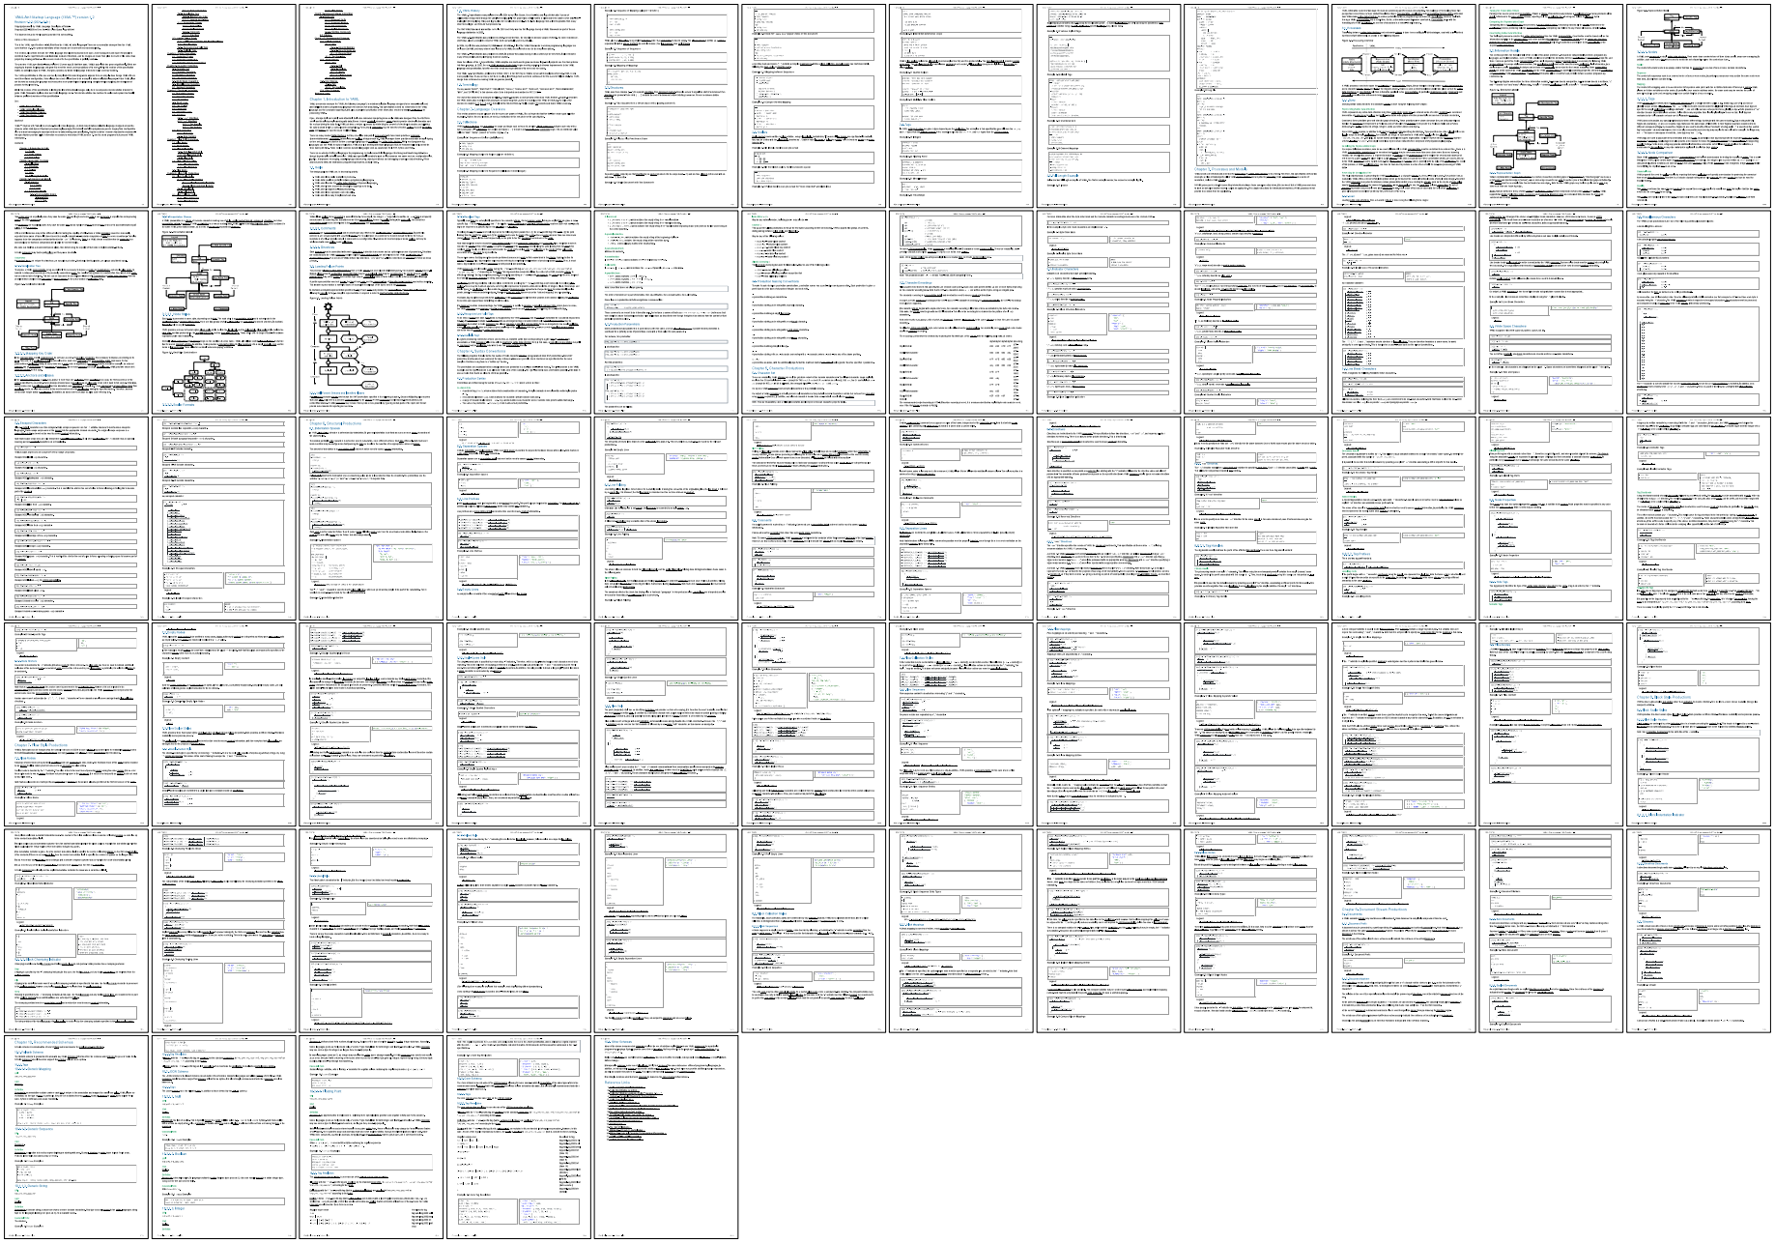
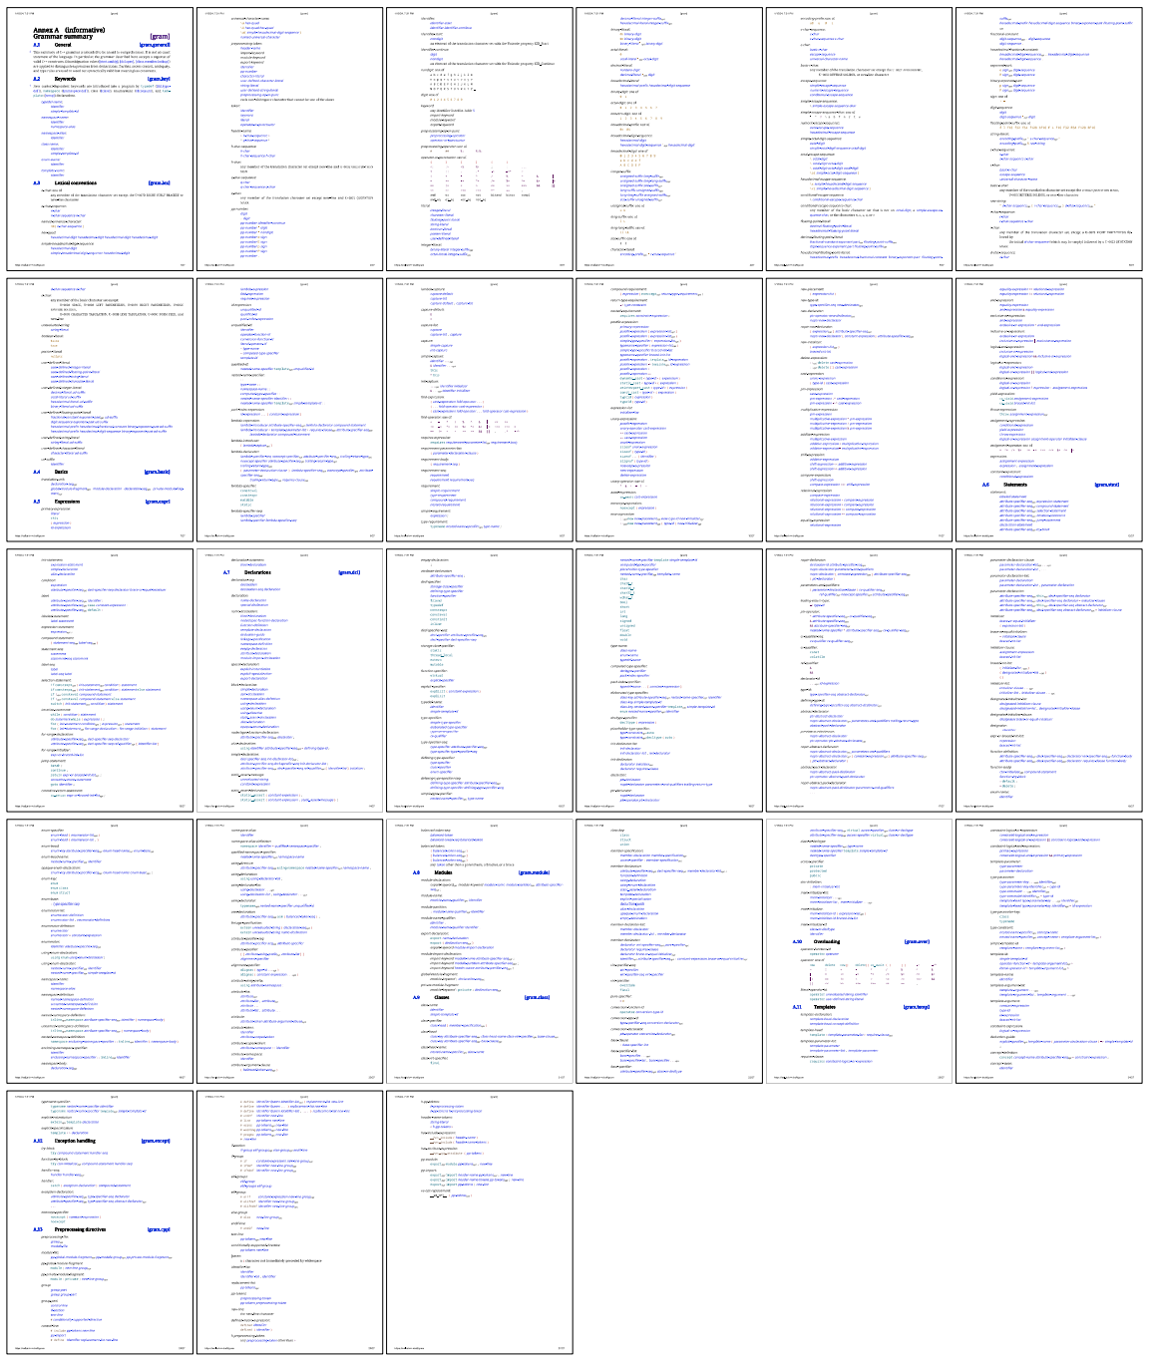
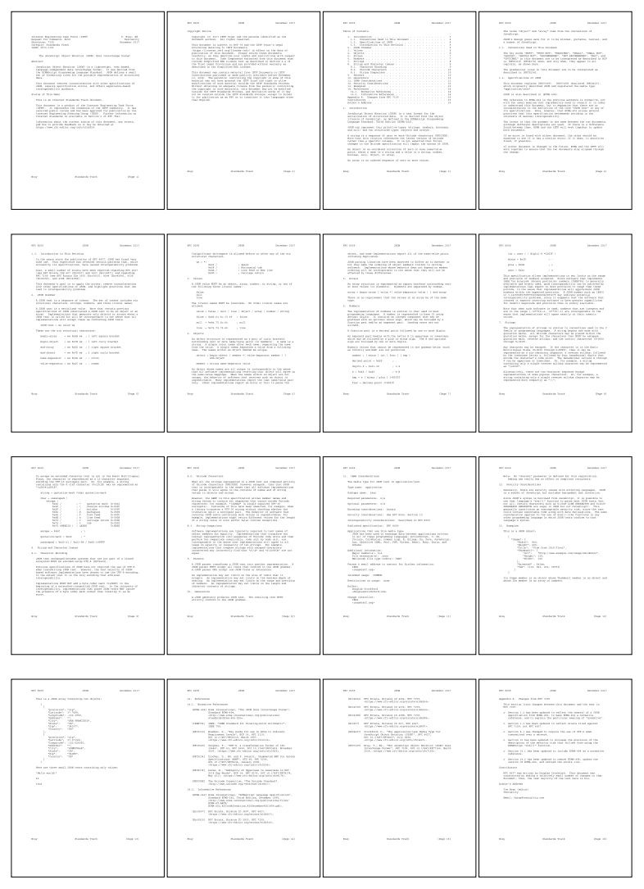
YAML
https://yaml.org/spec/1.2.2/
C++
https://eel.is/c++draft/#gram
entire
RFC 8259

Slide 8
Mapping of JSON types into C++
JSON |  | C++
null | null
Boolean | true or false | bool
number | 3.14 | int64_t, double
string | "hello" | std::string
array | [ 1, 2, 3 ] | std::vector<Value>
object | { "key": "value" } | std::unordered_map<std::string, Value>
keys are unordered

Slide 9
Mapping of JSON types into C++
C++17:
char — (usually) 8 bit integer type
namespace std {
using string = basic_string<char, char_traits<char>, allocator<char>>;
}
C++20:
char8_t — (at least) 8 bit integer type able to accommodate UTF-8 code units
namespace std {
using u8string = basic_string<char8_t, char_traits<char8_t>, allocator<char8_t>>;
}
What about interoperability between std::string and std::u8string? 🤷‍♀️

Slide 10
Mapping of JSON types into C++
JSON value is a union type
std::variant<std::monostate,
bool,
int64_t,
double,
std::string,
std::vector<Value>,
std::unordered_map<String, Value>>
null
struct Value;

Slide 11
Value type
struct Value {
using Null = std::monostate;
using Boolean = bool;
using String = std::string;
using Array = std::vector<Value>;
using Object = std::unordered_map<String, Value>;
using Variant =
std::variant<Null, Boolean, int64_t, double, String, Array, Object>;
//...
private:
//...
Variant m_data;
};

Slide 12
Value type
Value v; // default ctor
Value boolean = true;
Value string = "hello";
Value number = 42;

Slide 13
struct Value {
//...
Value() = default;
template<typename T,
std::enable_if_t<!std::is_same_v<detail::RemoveCVRef<T>, Value> &&
std::is_convertible_v<T&&, Variant>, int> = 0>
Value(T &&v) noexcept(std::is_nothrow_constructible_v<Variant, T&&>) :
m_data{ std::forward<T>(v) }
{}
Value(std::string_view s) :
m_data{ std::in_place_type<String>, s }
{}
//...
};
namespace detail {
template<typename T>
using RemoveCVRef = std::remove_cv_t<std::remove_reference_t<T>>;
}
safe to put into template paremeters

Slide 14
struct Value {
//...
Value() = default;
template<typename T>
requires (!std::is_same_v<std::remove_cvref_t<T>, Value> &&
std::is_convertible_v<T&&, Variant>)
Value(T &&v) noexcept(std::is_nothrow_constructible_v<Variant, T&&>) :
m_data{ std::forward<T>(v) }
{}
Value(std::string_view s) :
m_data{ std::in_place_type<String>, s }
{}
//...
};
C++20

Slide 15
struct Value {
//...
template<typename T>
std::enable_if_t<!std::is_same_v<detail::RemoveCVRef<T>, Value> &&
std::is_convertible_v<T&&, Variant>, Value>
Value &operator=(T &&v)
noexcept(std::is_nothrow_assignable_v<Variant, T&&>) {
variant() = std::forward<T>(v);
return *this;
}
Value &operator=(std::string_view s) {
variant().template emplace<String>(s);
return *this;
}
//...
};
need to be
the return type

Slide 16
struct Value {
//...
template<typename T,
std::enable_if_t<!std::is_same_v<detail::RemoveCVRef<T>, Value> &&
std::is_convertible_v<T&&, Variant>, int> = 0>
Value &operator=(T &&v)
noexcept(std::is_nothrow_assignable_v<Variant, T&&>);
//...
};
Value v;
v.operator=<bool, 0>(true);
v.operator=<bool, 1>(true);
v.operator=<bool, 2>(true);
v.operator=<bool, 3>(true);
v.operator=<bool, 4>(true);

Slide 17
struct Value {
//...
template<typename T>
std::enable_if_t<!std::is_same_v<detail::RemoveCVRef<T>, Value> &&
std::is_convertible_v<T&&, Variant>, Value>
&operator=(T &&v)
noexcept(std::is_nothrow_assignable_v<Variant, T&&>) {
variant() = std::forward<T>(v);
return *this;
}
Value &operator=(std::string_view s) {
variant().template emplace<String>(s);
return *this;
}
//...
};

Slide 18
struct Value {
//...
template<typename T>
requires (!std::is_same_v<std::remove_cvref_t<T>, Value> &&
std::is_convertible_v<T&&, Variant>)
Value &operator=(T &&v)
noexcept(std::is_nothrow_assignable_v<Variant, T&&>) {
variant() = std::forward<T>(v);
return *this;
}
Value &operator=(std::string_view s) {
variant().template emplace<String>(s);
return *this;
}
//...
};
C++20

Slide 19
struct Value {
//...
Value() = default;
template<typename T,
std::enable_if_t<!std::is_same_v<detail::RemoveCVRef<T>, Value> &&
std::is_convertible_v<T&&, Variant>, int> = 0>
Value(T &&v) noexcept(std::is_nothrow_constructible_v<Variant, T&&>);
Value(std::string_view s);
template<typename T>
std::enable_if_t<!std::is_same_v<detail::RemoveCVRef<T>, Value> &&
std::is_convertible_v<T&&, Variant>, Value>
Value &operator=(T &&v);
Value &operator=(std::string_view s);
//...
};
Which rule?
destructor
copy constructor
copy assignment
move constructor
move assignment
none of the above
rule of three
rule of five
rule of zero

Slide 20
struct Value {
//...
friend bool operator==(const Value &a, const Value &b) {
return a.variant() == b.variant();
}
friend bool operator!=(const Value &a, const Value &b) {
return a.variant() != b.variant();
}
//...
};

Slide 21
struct Value {
//...
friend bool operator==(const Value&, const Value&) = default;
//...
};
C++20
operator!= is synthesized from operator==

Slide 22
struct Value {
//...
[[nodiscard]] const Variant &variant() const& noexcept { return m_data; }
[[nodiscard]] Variant &variant() & noexcept { return m_data; }
[[nodiscard]] Variant &&variant() && noexcept {
return std::move(m_data);
}
[[nodiscard]] const Variant &&variant() const&& noexcept {
return std::move(m_data);
}
operator const Variant&() const& noexcept { return m_data; }
operator Variant&() & noexcept { return m_data; }
operator Variant&&() && noexcept { return std::move(m_data); }
operator const Variant&&() const&& noexcept { return std::move(m_data); }
//...
};

Slide 23
Value type
using Object = Value::Object;
using Array = Value::Array;
using String = Value::String;
using Boolean = bool;
using Null = std::monostate;
using Variant = Value::Variant;

Slide 24
Value type
void print(const Value &value) {
std::visit(Overloaded{
[](Null) { std::cout << "null"; },
[](bool b) { std::cout << "boolean: " << (b ? "true" : "false"); },
[](int64_t i) { std::cout << "integer: " << i; },
[](double d) { std::cout << "decimal: " << d; },
[](const std::string &s) { std::cout << "string: " << s; },
[](const Array&) { std::cout << "array"; },
[](const Object&) { std::cout << "object"; }
}, value.variant());
std::cout << '\n';
}
template<typename... F>
struct Overloaded : F... { using F::operator()...; };
template<typename... F>
Overloaded(F...) -> Overloaded<F...>; // needed until C++20

Slide 25
Value type
Value boolean = true;
print(boolean);
output:
Clang 18 -std=c++17 | MSVC (VS 2022) -std:c++17
boolean: true | boolean: true

Slide 26
Value type
Value string = "hello";
print(string);
output:
Clang 18 -std=c++17 | MSVC (VS 2022) -std:c++17
string: hello | boolean: true

Slide 27
Value type
Value number = 42;
print(number);
output:
Clang 18 -std=c++17 | MSVC (VS 2022) -std:c++17
integer: 42 | error : no viable conversion from 'int' to 'Value'

Slide 28
In C++17 variant alternative is chosen as if by overload resolution:
void test(std::monostate); // Null
void test(bool); // Boolean
void test(int64_t); // integer
void test(double); // decimal
void test(std::string); // String
void test(std::vector<Value>); // Array
void test(std::unordered_map<String, Value>) // Object
test(true); // calls test(bool)
test("hello"); // calls test(bool)
test(42); // error : call to 'test' is ambiguous
This nonsense is fixed in P0608.
MS left the original behavior in
-std=c++17 mode
for backwards compatibility.

Slide 29
Value type
#if defined(_MSC_VER) && \
(defined(_MSVC_LANG) && _MSVC_LANG > __cplusplus && \
_MSVC_LANG == 201703L || __cplusplus == 201703L)
#define NEED_WORKAROUND_FOR_UNIMPLEMENTED_P0608
#endif

Slide 30
Value type
Microsoft made P0608 behavior unconditional in -std=c++17 mode in VS 2022 17.12 release.
#if defined(_MSC_VER) && _MSVC_STL_UPDATE < 202408L && \
(defined(_MSVC_LANG) && _MSVC_LANG > __cplusplus && \
_MSVC_LANG == 201703L || __cplusplus == 201703L)
#define NEED_WORKAROUND_FOR_UNIMPLEMENTED_P0608
#endif

Slide 31
struct Value {
//...
Value() = default;
template<typename T,
std::enable_if_t<!std::is_same_v<detail::RemoveCVRef<T>, Value> &&
std::is_convertible_v<T&&, Variant>, int> = 0>
Value(T &&v) noexcept(std::is_nothrow_constructible_v<Variant, T&&>);
Value(std::string_view s);
#if defined(NEED_WORKAROUND_FOR_UNIMPLEMENTED_P0608)
Value(const char *s) : m_data{ std::in_place_type<String>, s } {}
Value(int i) noexcept : m_data{ std::in_place_type<int64_t>, i } {}
#endif
//...
};

Slide 32
//...
template<typename T>
std::enable_if_t<!std::is_same_v<detail::RemoveCVRef<T>, Value> &&
std::is_convertible_v<T&&, Variant>,
Value> &operator=(T &&v);
Value &operator=(std::string_view s);
#if defined(NEED_WORKAROUND_FOR_UNIMPLEMENTED_P0608)
Value &operator=(const char *s) {
variant().template emplace<String>(s);
return *this;
}
Value &operator=(int i) noexcept {
variant().template emplace<int64_t>(i);
return *this;
}
#endif
//...

Slide 33
Value type
 | output:
Value boolean = true; print(boolean); | boolean: true
Value string = "hello"; print(string); | string: hello
Value number = 42; print(number); | integer: 42

Slide 34
using json = nlohmann::json;
json j2 = {
{"pi", 3.141},
{"happy", true},
{"name", "Niels"},
{"nothing", nullptr},
{"answer", {
{"everything", 42}
}},
{"list", {1, 0, 2}},
{"object", {
{"currency", "USD"},
{"value", 42.99}
}}
};

Slide 35
json x = {
{}
};
std::cout << x.dump(2) << '\n';
outputs:
[
null
]

Slide 36
json x = {
{ "value" }
};
std::cout << x.dump(2) << '\n';
outputs:
[
[
"value"
]
]

Slide 37
json x = {
{ "key?", "value?" }
};
std::cout << x.dump(2) << '\n';
outputs:
{
"key?": "value?"
}

Slide 38
json x = {
{ "key?", "value?", "oops" }
};
std::cout << x.dump(2) << '\n';
outputs:
[
[
"key?",
"value?",
"oops"
]
]

Slide 39
Value type
Value json = Object{
{ "null", Null{} },
{ "boolean", true },
{ "integer", 42 },
{ "decimal", 3.14 },
{ "string", "hello" },
{ "array", Array{
1, 2, 3
} },
{ "nested object", Object{
{ "foo", "bar" }
} }
};
std::unordered_map<String, Value>
std::vector<Value>

Slide 40
struct Value {
//...
[[nodiscard]] bool isObject() const noexcept {
return std::holds_alternative<Object>(variant());
}
[[nodiscard]] const Object &asObject() const& {
return std::get<Object>(variant());
}
[[nodiscard]] Object &asObject() & {
return std::get<Object>(variant());
}
[[nodiscard]] Object &&asObject() && {
return std::move(std::get<Object>(variant()));
}
//...
};

Slide 41
struct Value {
//...
[[nodiscard]] bool isArray() const noexcept {
return std::holds_alternative<Array>(variant());
}
[[nodiscard]] const Array &asArray() const& {
return std::get<Array>(variant());
}
[[nodiscard]] Array &asArray() & {
return std::get<Array>(variant());
}
[[nodiscard]] Array &&asArray() && {
return std::move(std::get<Array>(variant()));
}
//...
};

Slide 42
struct Value {
//...
[[nodiscard]] bool isString() const noexcept {
return std::holds_alternative<String>(variant());
}
[[nodiscard]] const String &asString() const& {
return std::get<String>(variant());
}
[[nodiscard]] String &asString() & {
return std::get<String>(variant());
}
[[nodiscard]] String &&asString() && {
return std::move(std::get<String>(variant()));
}
//...
};

Slide 43
struct Value {
//...
[[nodiscard]] bool isDouble() const noexcept {
return std::holds_alternative<double>(variant());
}
[[nodiscard]] double asDouble() const {
return std::get<double>(variant());
}
[[nodiscard]] double &asDouble() {
return std::get<double>(variant());
}
//...
};

Slide 44
struct Value {
//...
[[nodiscard]] bool isInt() const noexcept {
return std::holds_alternative<int64_t>(variant());
}
[[nodiscard]] int64_t asInt() const {
return std::get<int64_t>(variant());
}
[[nodiscard]] int64_t &asInt() {
return std::get<int64_t>(variant());
}
//...
};

Slide 45
struct Value {
//...
[[nodiscard]] bool isBool() const noexcept {
return std::holds_alternative<Boolean>(variant());
}
[[nodiscard]] Boolean asBool() const {
return std::get<Boolean>(variant());
}
[[nodiscard]] Boolean &asBool() {
return std::get<Boolean>(variant());
}
//...
};

Slide 46
struct Value {
//...
[[nodiscard]] bool isNull() const noexcept {
return std::holds_alternative<Null>(variant());
}
//...
};

Slide 47
Value type
Value json = Object{
//...
};
assert(json.isObject());
auto &object = json.asObject();
assert(object["array"].isArray());
auto &array = object["array"].asArray();
array[0]; // can do whatever std::vector allows
assert(object["nested object"].isObject());
auto &nested = object["nested object"].asObject();
nested["foo"]; // can do whatever std::unordered_map allows

Slide 48
using json = nlohmann::json;
json j2 = {
//...
{"list", {1, 0, 2}},
//...
};
j2["list"][0];

Slide 49

using json = nlohmann::json;
json x; // null
x[0]; // now it's an array: [ null ]
json y; // null
y["foo"]; // now it's an object: { "foo": null }
json z = 42;
z["foo"]; // compiles, throws an exception

Slide 50
Value type
Value x = Object{
{ "items", Array{ 1, 2, 3 } }
};
Value *item = x.resolve("items", 0);
if (item)
print(*item); // use *item
implies that x is an object
implies that
x.asObject()["items"]
is an array

Slide 51
Value type
Value y = Array{
Object{ { "foo", 1 } }, "two", 3
};
Value *foo = y.resolve(0, "foo");
if (foo)
print(*foo); // use *foo
implies that y is an array
implies that
y.asArray()[0]
is an object

Slide 52
Value z = Array{
Object{
{ "foo", Object{
{ "bar", Array{ 1, 2, 3 } }
} }
},
42
};
auto *v = z.resolve(0, "foo", "bar", 2);
if (v)
print(*v); // use *v

Slide 53
Value z = Array{
Object{
{ "foo", Object{
{ "bar", Array{ 1, 2, 3 } }
} }
},
42
};
auto *v = z.resolve(0);
if (v)
print(*v); // use *v

Slide 54
Value z = Array{
Object{
{ "foo", Object{
{ "bar", Array{ 1, 2, 3 } }
} }
},
42
};
auto *v = z.resolve(1);
if (v)
print(*v); // use *v

Slide 55
Value z = Array{
Object{
{ "foo", Object{
{ "bar", Array{ 1, 2, 3 } }
} }
},
42
};
auto *v = z.resolve(0, "foo", 2);
if (v)
print(*v); // use *v
???

Slide 56
struct Value {
//...
private:
const Value *resolveImpl(size_t index) const noexcept {
auto *array = std::get_if<Array>(&variant());
if (array && index < array->size())
return &(*array)[index];
return nullptr;
}
const Value *resolveImpl(const String &key) const noexcept {
if (auto *object = std::get_if<Object>(&variant())) {
if (auto i = object->find(key); i != object->end())
return &i->second;
}
return nullptr;
}
//...

Slide 57
Value type
struct Value {
//...
template<typename... T>
[[nodiscard]] std::enable_if_t<sizeof...(T) >= 1 &&
detail::AreTypesConvertibleToStringXorSizeT<T&&...>,
const Value*> resolve(T&&... refTokens) const noexcept {
const Value *value = this;
((value = value->resolveImpl(std::forward<T>(refTokens))) && ...);
return value;
}
//...
};

Slide 58
Value type
struct Value {
//...
template<typename... T>
requires ( sizeof...(T) >= 1 &&
detail::AreTypesConvertibleToStringXorSizeT<T&&...>)
[[nodiscard]] const Value* resolve(T&&... refTokens) const noexcept {
const Value *value = this;
((value = value->resolveImpl(std::forward<T>(refTokens))) && ...);
return value;
}
//...
};
C++20
namespace detail {
template<typename... T>
inline constexpr bool AreTypesConvertibleToStringXorSizeT =
((std::is_convertible_v<T, std::string> != // exclusive OR
std::is_convertible_v<T, size_t>) && ...);
}

Slide 59
Value type
struct Value {
//...
template<typename... T>
requires ( sizeof...(T) >= 1 &&
detail::AreTypesConvertibleToStringXorSizeT<T&&...>)
[[nodiscard]] const Value* resolve(T&&... refTokens) const noexcept {
const Value *value = this;
(static_cast<bool>(
value = value->resolveImpl(std::forward<T>(refTokens))
) && ...);
return value;
}
//...
};
C++20

Slide 60
Value type
struct Value {
//...
template<typename... T>
requires ( sizeof...(T) >= 1 &&
detail::AreTypesConvertibleToStringXorSizeT<T&&...>)
[[nodiscard]] const Value* resolve(T&&... refTokens) const noexcept {
const Value *value = this;
(void)(static_cast<bool>(
value = value->resolveImpl(std::forward<T>(refTokens))
) && ...);
return value;
}
//...
};
C++20

Slide 61
Value type
struct Value {
//...
template<typename... T>
requires (sizeof...(T) >= 1 &&
detail::AreTypesConvertibleToStringXorSizeT<T&&...>)
[[nodiscard]] Value* resolve(T&&... refTokens) noexcept {
return const_cast<Value*>(
std::as_const(*this).resolve(std::forward<T>(refTokens)...)
);
}
//...
};
C++20
Value x = Object{
{ "items", Array{ 1, 2, 3 } }
};
Value *item = x.resolve("items", 0);
if (item)
print(*item); // use *item

Slide 62
Value type
struct Value {
//...
using Array = std::vector<Value>;
using Object = std::unordered_map<String, Value>;
//...
private:
//...
Variant m_data;
};
Value is incomplete at this point

Slide 63
Value type
std::vector has to support incomplete types according to the standard
std::unordered_map does not have to support incomplete types, but de facto supports them in all major implementations of the C++ standard library
except for libstdc++ versions <12

Slide 64
Value type
struct Value {
//...
private:
//...
#if !defined(_GLIBCXX_RELEASE) || _GLIBCXX_RELEASE >= 12
Variant m_data;
#else
struct Workaround final {
//...
} m_data;
#endif
};

Slide 65
Value type
struct Workaround final {
//...
private:
using DummyUnorderedMap = std::unordered_map<String, Array>;
using DummyVariant = std::variant<Null, Boolean, int64_t,
double, String, Array,
DummyUnorderedMap>;
alignas(DummyVariant) uint8_t storage[sizeof(DummyVariant)];
} m_data;
std::aligned_storage is deprecated in C++23

Slide 66
struct Workaround final {
Workaround() noexcept { ::new(&storage) Variant{}; }
Workaround(const Workaround &other) {
::new(&storage) Variant{ other.operator const Variant&() };
}
Workaround(Workaround &&other)
noexcept(std::is_nothrow_move_constructible_v<Variant>) {
::new(&storage) Variant{ std::move(other.operator Variant&()) };
}
template<typename... T>
Workaround(T&&... v)
noexcept(std::is_nothrow_constructible_v<Variant, T&&...>) {
::new(&storage) Variant{ std::forward<T>(v)... };
}
//...
} m_data;

Slide 67
struct Workaround final {
//...
~Workaround() {
static_assert(sizeof(DummyVariant) == sizeof(Variant));
static_assert(alignof(DummyVariant) == alignof(Variant));
operator Variant&().~Variant();
}
auto &operator=(const Workaround &other) {
return operator Variant&() = other.operator const Variant&();
}
auto &operator=(Workaround &&other)
noexcept(std::is_nothrow_move_assignable_v<Variant>) {
return operator Variant&() = std::move(other.operator Variant&());
}
//...
} m_data;

Slide 68
struct Workaround final {
Workaround() noexcept;
Workaround(const Workaround &other);
Workaround(Workaround &&other)
noexcept(std::is_nothrow_move_constructible_v<Variant>);
template<typename... T>
Workaround(T&&... v)
noexcept(std::is_nothrow_constructible_v<Variant, T&&...>);
~Workaround();
auto &operator=(const Workaround &other);
auto &operator=(Workaround &&other)
noexcept(std::is_nothrow_move_assignable_v<Variant>);
//...
} m_data;
Which rule?
Rule of five

Slide 69
struct Workaround final {
//...
operator const Variant&() const& noexcept {
return *std::launder(reinterpret_cast<const Variant*>(&storage));
}
operator Variant&() & noexcept {
return *std::launder(reinterpret_cast<Variant*>(&storage));
}
operator Variant&&() && noexcept {
return std::move(operator Variant&());
}
operator const Variant&&() const&& noexcept {
return std::move(operator const Variant&());
}
//...
} m_data;

Slide 70
Value type
struct Value {
//...
private:
//...
#if !defined(_GLIBCXX_RELEASE) || _GLIBCXX_RELEASE >= 12
Variant m_data;
#else
struct Workaround final {
//...
} m_data;
#endif
};

Slide 71
visit()
Value v;
auto visitor = [](auto&&) {/*...*/};
std::visit(visitor, v); // does not work
std::visit(visitor, v.variant());
visit(visitor, v);

Slide 72
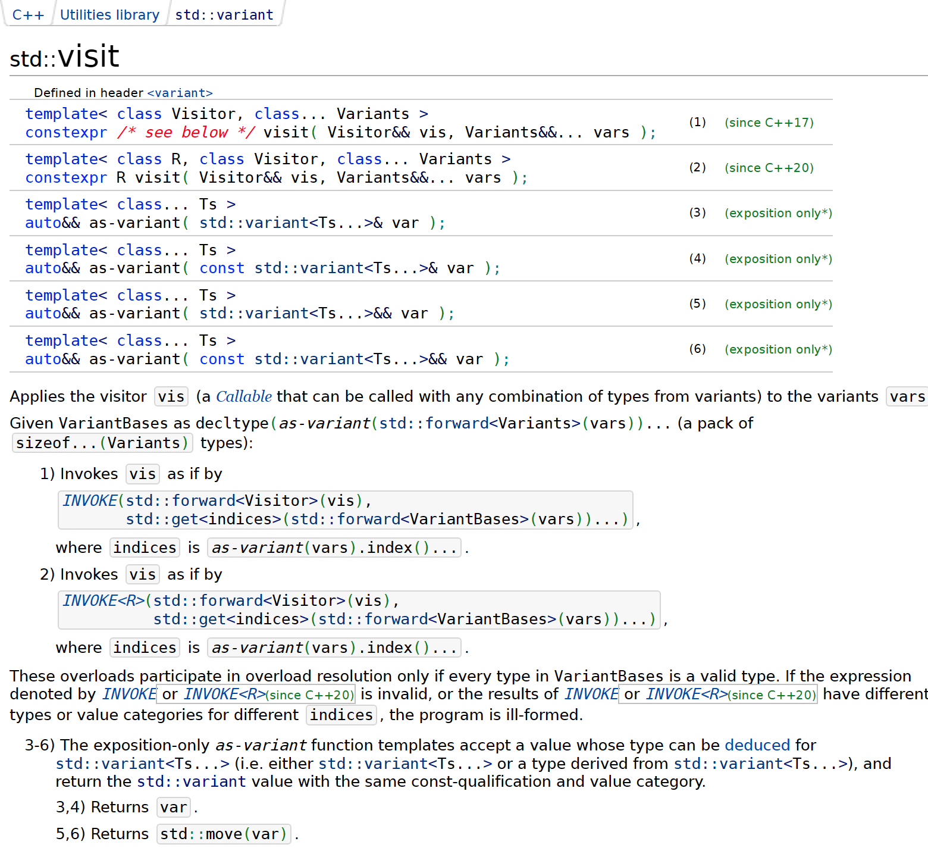
Argument to std::visit() can be either
std::variant<T...>
or
a type derived from std::variant<T...>

Slide 73
visit()
C++20
template<typename F, typename T>
requires (std::is_base_of_v<detail::RawBaseValueType<T>,
std::remove_cvref_t<T>>)
decltype(auto) visit(F &&f, T &&value) {
using BaseValueType = detail::RawBaseValueType<T>;
return std::visit(std::forward<F>(f),
std::forward<T>(value).BaseValueType::variant());
}

Slide 74
visit()
C++20
namespace detail {
void GetValue(...); // intentionally not implemented
Value GetValue(const Value&); // intentionally not implemented
template<typename T>
using RawBaseValueType =
decltype(GetValue(std::declval<std::remove_cvref_t<T>>()));
}

Slide 75
decltype(auto)
T
returns T as deduced in a call
test(expr)
to function template
template<typename T>
void test(T);
auto foo() {
return expr;
}
const auto &bar() {
return expr;
}
decltype(expr) baz() {
return expr;
}
T
returns T as deduced in a call
test(expr)
to function template
template<typename T>
void test(const T&);
auto

Slide 76
visit()
C++20
template<typename F, typename T>
requires (std::is_base_of_v<detail::RawBaseValueType<T>,
std::remove_cvref_t<T>>)
decltype(auto) visit(F &&f, T &&value) {
using BaseValueType = detail::RawBaseValueType<T>;
return std::visit(std::forward<F>(f),
std::forward<T>(value).BaseValueType::variant());
}

Slide 77
Allocator support
struct Value {
using Null = std::monostate;
using Boolean = bool;
using String = std::string;
using Array = std::vector<Value>;
using Object = std::unordered_map<String, Value>;
using Variant =
std::variant<Null, Boolean, int64_t, double, String, Array, Object>;
//...
};

Slide 78
namespace detail {
template<typename Allocator, typename T>
using ReboundAllocator =
typename std::allocator_traits<Allocator>::template rebind_alloc<T>;
}
template<typename Allocator>
struct BasicValue {
using Null = std::monostate;
using Boolean = bool;
using String = std::basic_string<char, std::char_traits<char>,
detail::ReboundAllocator<Allocator, char>>;
using Array = std::vector<BasicValue,
detail::ReboundAllocator<Allocator, BasicValue>>;
using Object = std::unordered_map<String, BasicValue,
std::hash<String>, std::equal_to<String>,
detail::ReboundAllocator<Allocator,
std::pair<const String, BasicValue>>>;
using Variant =
std::variant<Null, Boolean, int64_t, double, String, Array, Object>;
//...
};

Slide 79
Allocator support
template<typename Allocator>
struct BasicValue {
//...
BasicValue(const Allocator&) noexcept {}
BasicValue(const BasicValue &other, const Allocator &a) :
m_data{ construct(other.variant(), a) } {}
BasicValue(BasicValue &&other, const Allocator &a) :
m_data{ construct(std::move(other.variant()), a) } {}
//...
};
uses-allocator machinery support

Slide 80
template<typename V>
Variant construct(V &&other, const Allocator &a) {
if (other.valueless_by_exception())
return std::forward<V>(other);
return std::visit([&a](auto &&val) {
using U = decltype(val);
using T = detail::RemoveCVRef<U>;
if constexpr (std::is_same_v<T, Object> ||
std::is_same_v<T, Array> ||
std::is_same_v<T, String>) {
return Variant{ std::in_place_type<T>, std::forward<U>(val), a };
}
else {
return Variant{ std::in_place_type<T>, val };
}
}, std::forward<V>(other));
}
passing allocator a

Slide 81
Allocator support
template<typename Allocator>
struct BasicValue {
//...
};
using Value = BasicValue<std::allocator<char>>;
namespace std {
template<typename A1, typename A2> // uses-allocator machinery support
struct uses_allocator<BasicValue<A1>, A2> : true_type {};
}

Slide 82
Allocator support
struct Workaround final {
//...
private:
using DummyUnorderedMap = std::unordered_map<String, Array,
std::hash<String>, std::equal_to<String>,
detail::ReboundAllocator<Allocator,
std::pair<const String, Array>>>;
using DummyVariant = std::variant<Null, Boolean, int64_t,
double, String, Array,
DummyUnorderedMap>;
alignas(DummyVariant) uint8_t storage[sizeof(DummyVariant)];
} m_data;

Slide 83
Allocator support
C++20
namespace detail {
void GetValue(...); // intentionally not implemented
template<typename Allocator>
BasicValue<Allocator> GetValue(const BasicValue<Allocator>&);
template<typename T>
using RawBaseValueType =
decltype(GetValue(std::declval<std::remove_cvref_t<T>>()));
}

Slide 84
Allocator support
using PmrValue =
BasicValue<std::pmr::polymorphic_allocator<char>>;
PmrValue a = "hello"; // uses std::pmr::get_default_resource()

Slide 85


Most Malleable Memory Management Method in C++ by Björn Fahller
https://youtu.be/ptMFLSAkRj0

Slide 86
Allocator support
struct Foo {
Value v;
std::vector<int> bar;
};
const Array a;
Value c;
c = a;
Clang (any version) + libstdc++ version <12:
error: call to implicitly-deleted copy constructor of
'std::pair<const std::basic_string<char>, BasicValue<std::allocator<char>>>'
https://github.com/llvm/llvm-project/issues/84487
[clang] fails to compile valid code involving variant and unordered_map with
libstdc++ version <12

Slide 87

Allocator support
#if defined(_GLIBCXX_RELEASE) && _GLIBCXX_RELEASE < 12 && \
defined(__clang__)
// clang needs this for some reason
static_assert(std::is_copy_constructible_v<Value>);
#endif

Slide 88
What we've covered
implemented a variant-like value type for working with JSON values
rule of zero
worked around bogus variant construction/assignment in MS implementation (fixed within P0608, and in the latest VS release)
implemented rich interface that's easy to use correctly and hard to use incorrectly
worked around inability to use incomplete types (std::unordered_map in libstdc++ versions <12)
rule of five
added allocator support, uses-allocator functionality support
worked around Clang compilation bug with libstdc++ versions <12

Slide 89

ONE DOES NOT SIMPLY
WRITE A JSON LIBRARY IN C++

Slide 90
minjsoncpp
Minimalistic JSON C++ library
https://github.com/toughengineer/minjsoncpp

Slide 91

JSON in C++: designing a type for working with JSON values
Pavel Novikov
@cpp_ape
Thanks to Stephan T. Lavavej for clarifications on MS implementation.
Slides: bit.ly/4ifnxsv

Slide 92
References
RFC 8259: The JavaScript Object Notation (JSON) Data Interchange Format https://datatracker.ietf.org/doc/html/rfc8259
“A sane variant converting constructor” by Zhihao Yuan https://wg21.link/p0608
Macro _MSVC_STL_UPDATE https://github.com/microsoft/STL/wiki/Macro-_MSVC_STL_UPDATE
Deprecate std::aligned_storage and std::aligned_union by CJ Johnson https://wg21.link/p1413
Most Malleable Memory Management Method in C++ by Björn Fahller https://www.youtube.com/watch?v=ptMFLSAkRj0
[clang] fails to compile valid code involving variant and unordered_map with libstdc++ version <12 https://github.com/llvm/llvm-project/issues/84487
minjsoncpp — Minimalistic JSON C++ library https://github.com/toughengineer/minjsoncpp

